Slide 1
Business Analytics
Toolbox - BA775
Summer 2021
Lecture 09
Professor: Mohammad Soltanieh-ha

Slide 2


Slide 3
Topics Covered
Overview of Window functions from DataCamp - Ch 4.4 Intermediate SQL
JSON in 10 Minutes (you can ignore the JavaScript part at the end)
Machine Learning APIs
Vision API
Optical Character Recognition (OCR) method of the Vision API
Translation API
Natural Language API
Natural Language API
Sentiment analysis

Slide 4
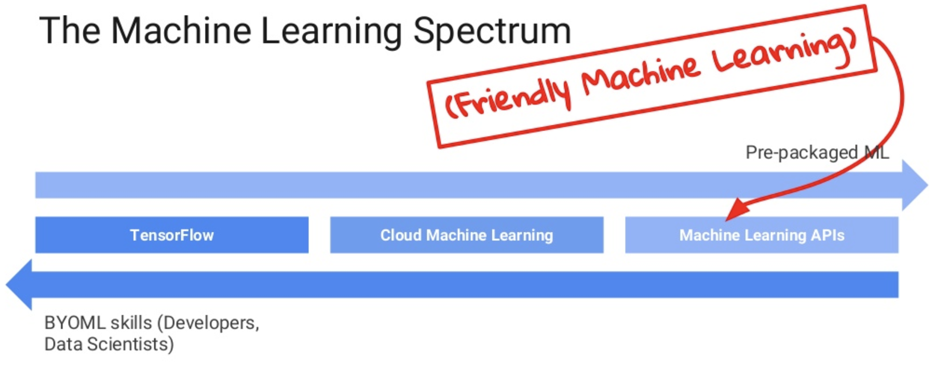
ML on GCP

Slide 5
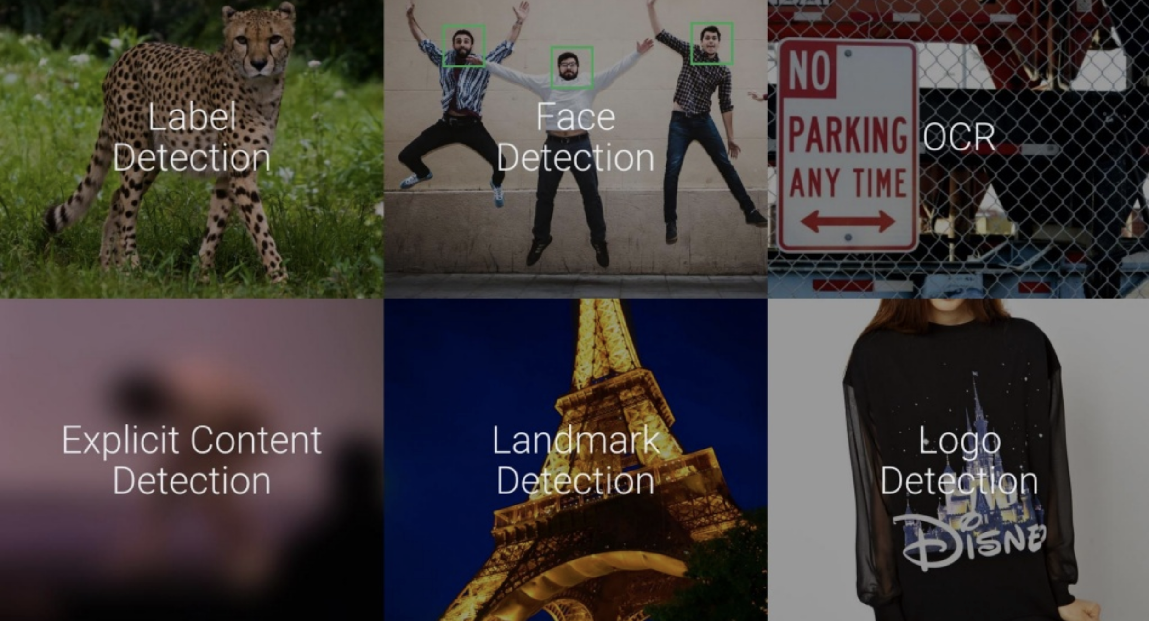
Vision API

Slide 6
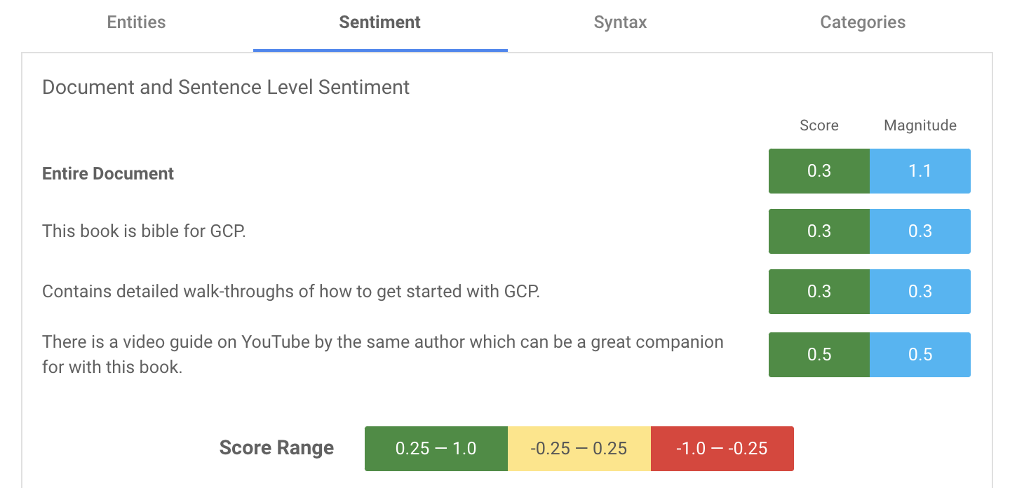
Natural Language API
Go to Google's Natural Language API to check out (free UI tool is not available anymore)
Natural Language API’s sentiment analysis
and AutoML Natural Language
Try the following review for sentiment analysis (Amazon review on one of our textbooks):
“This book is bible for GCP. Contains detailed walk-throughs of how to get started with GCP. There is a video guide on YouTube by the same author which can be a great companion for with this book.”

Slide 7

Your Turn
QLab T: Extract, Analyze, and Translate Text from Images with the Cloud ML APIs - 00:50
What you will learn in this lab
Creating a Vision API request and calling the API with curl
Using the text detection (OCR) method of the Vision API
Using the Translation API to translate text from your image
Using the Natural Language API to analyze the text

Slide 8
Your Turn
QLab U*: Working with JSON, Arrays, and Structs in BigQuery - 01:15
What you will learn in this lab
working with semi-structured data (ingesting JSON, Array data types) inside of BigQuery
Denormalizing your schema into a single table with nested and repeated fields

Slide 9
What Was Covered in BA775
Cloud Computing
Databases (BigQuery/MySQL)
Virtual Machines (Vertex AI notebooks and Compute Engine VMs)
Cloud Storage
Cloud project & billing management
Dashboards
Tableau
Data Studio
Best practices
Introduction to Machine Learning
BQML
ML APIs
SQL

Slide 10
SQL Syntax Covered in BA775
SQL syntax
SELECT
SELECT DISTINCT
Aggregation functions: COUNT / SUM / MIN / MAX
Filtering with WHERE using AND / OR / BETWEEN / LIKE / NOT LIKE
ORDER BY
GROUP BY and filtering groups by HAVING
CASTing data types
CONCATenation and STRING_AGG with strings
TIMESTAMP, DATE, DATETIME and corresponding EXTRACT & PARSE functionalities
CURRENT_TIMESTAMP, CURRENT_DATE
IF(cond, true_result, else_result)
CREATing, UPDAT(E)ing them, INSERTing data, and data ingestion

Slide 11
SQL Syntax Covered in BA775
SQL syntax
Checking missing values by IS NULL & IS NOT NULL
JOINs
UNION ALL & UNION DISTINCT
Nested queries and WITH clause (Common Table Expressions - CTEs)
CASE Statement
Date partitioned tables
ARRAYs and STRUCTs
Simple ML with SQL (BQML)
FARM_FINGERPRINT to get a random sample
Window functions - OVER clause and PARTITIONs

Slide 12
Optional Online Courses
Introduction to Tableau - DataCamp (not free to us)
Analyzing Data in Tableau - DataCamp (not free to us)
Exploratory Data Analysis in SQL - DataCamp
Data-Driven Decision Making in SQL - DataCamp
Applying SQL to Real-World Problems - DataCamp
Analyzing Business Data in SQL - DataCamp
Reporting in SQL - DataCamp
Business Transformation with Google Cloud - Coursera

Slide 13
Course Evaluation
Please use the link shared on Zoom to complete the course evaluation.

Slide 14

Activity
Complete the Qwiklab survey by Wednesday, Sep 1 @ 5 p.m.
Final presentations ( Zoom - use the same link as the lectures)
Cohort B1: Tuesday, 8/30 - 9 a.m. - noon ET
Cohort B2: Tuesday, 8/30 - 1 p.m. - 4 p.m. ET

